Slide 1


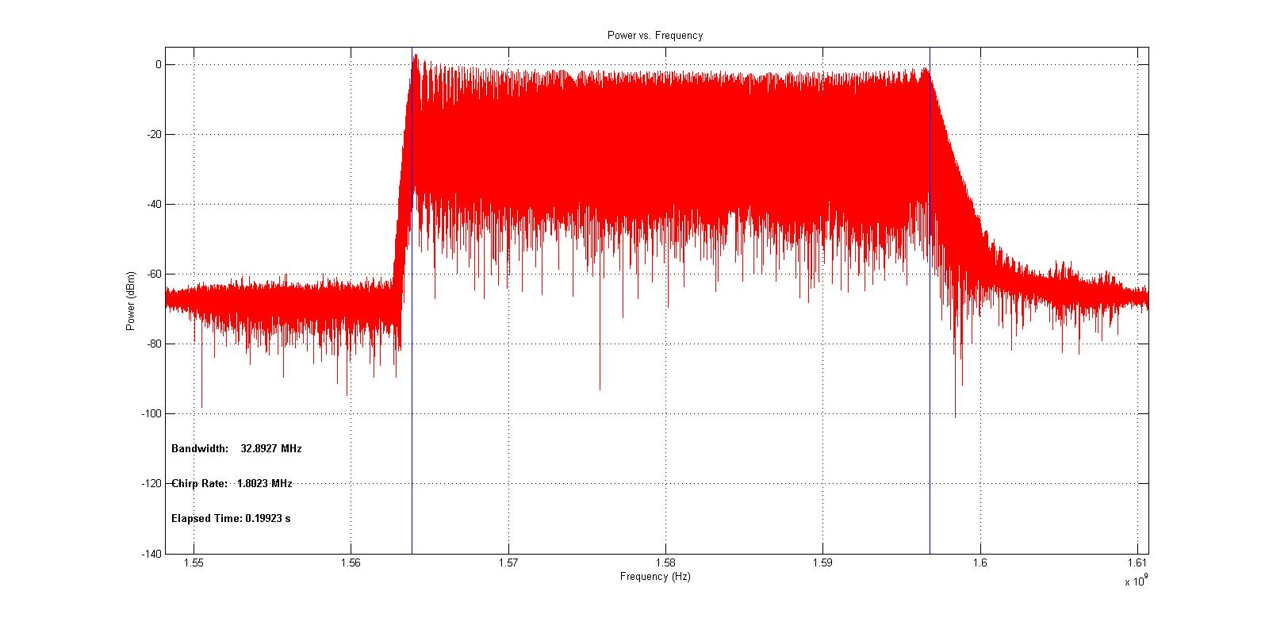
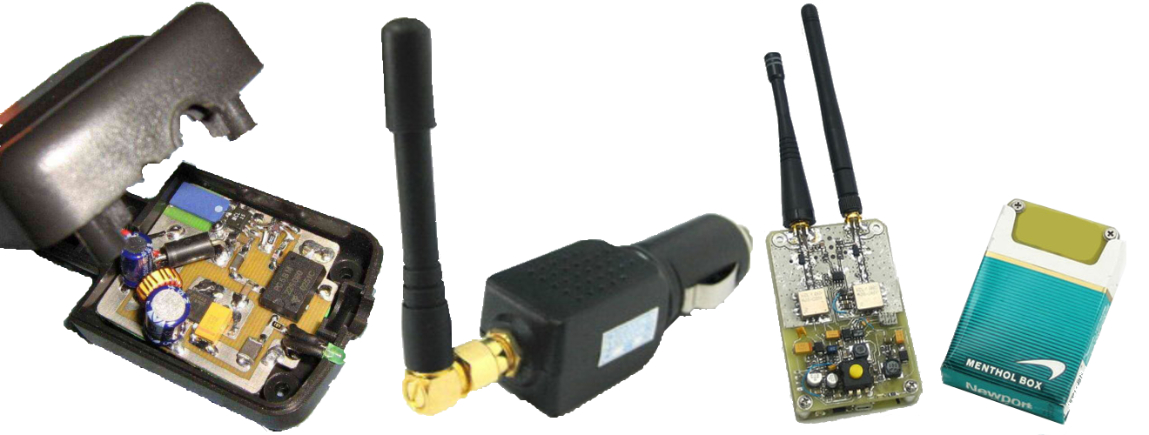
GPS Jamming Detection
Introduction
GPS systems are used for much more than finding your way home or tacking cargo. In fact GPS has become an essential part if modern day systems. Sensitive timing applications such as medical pagers, cellphone towers, and stalk market trades utilize the precise clock information from GPS to hand off signals between towers or time stamp transactions. Because of this GPS jammers have become increasingly hazardous for the modern infrastructure.
Performance
Solution
To help reduce the use of GPS jammers primarily used by civilian drivers a portable detector was developed. The first design consideration was functionality.
The device is aimed to work independent of the signal capture system. In order to accomplish this a set requirement was established that the detector would use IQ data as it’s data input do to its common use and formatting standards.
To allow for portability the device should by implemented on a FPGA. this will also decrease the processing time of the detection algorithm.
Program
The program operates on a Xilinx Zedboard using the zynq 7000 FPGA.
User Input
Program expects a Tar file containing XML and 32bit floating point interleaved IQ data.
Device communicates with an external computer via TCP connection
Output
Exports a text document containing the chirp rate of the detected jammer.
Aluminates an onboard LED while a jammer is detected.
Conclusion
The program satisfies all requirements but may be improved by:
Adding additional algorithms to distinguish between CW and Pulse jammers.
Using a cross correlation algorithm to increase dynamic range by effectively reducing the noise floor
Preform a statically analysis of the accuracy of the detection program
Resources
Logan scott, introduction to GPS interference and Mitigations, January 2015
Department of Electrical and Computer Engineering

